Slide 1
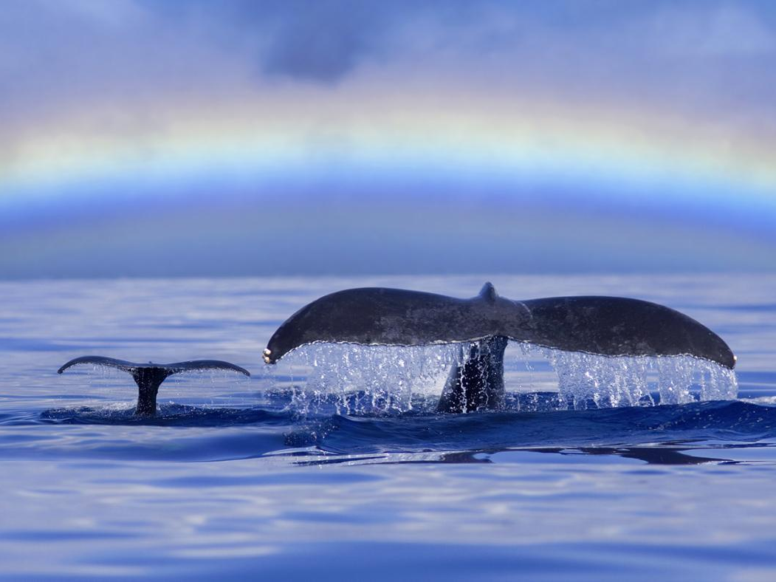

DNA Fingerprinting MiniLab

Slide 2
Learning Objectives
Technical Objectives
Correctly use an adjustable volume micropipette
Prepare, load, and run an agarose gel
Document gel electrophoresis results
Intellectual Objectives
Understand the principles of gel electrophoresis and its importance in molecular biology and genetics
Analyze patterns of DNA bands run on an agarose gel and form a conclusion about parentage
Appreciate how genetics can be used to trace family history in people and animals

Slide 3
NGSS Alignment for DNA Fingerprinting MiniLab
Phenomenon | How can we use DNA samples to determine paternity?
Grade Level | Basic genetics, electrophoresis, and data analysis: 4-12 Student worksheet: grades 9-12 With additional teacher support: grades 4-8
Disciplinary core ideas | LS1.A Structure and Function LS1.B Growth and Development of Organisms LS3.A Inheritance of Traits LS3.B Variation of Traits Interdependence of Science, Engineering and Technology
Science and engineering practices | Analyzing and interpreting data
Crosscutting concepts | Recognizing and analyzing patterns in nature and engineered systems

Slide 4
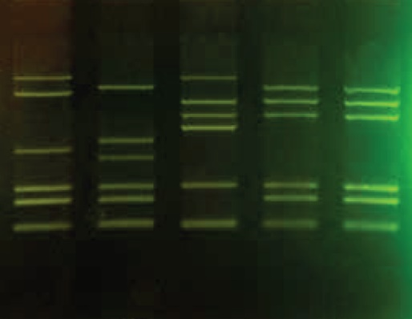
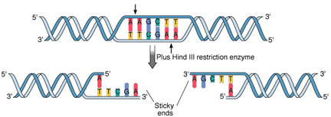
How does DNA fingerprinting work?
Genomic DNA is cut with restriction enzymes, which recognize specific base pair sequences.
Because of differences in genomic sequence, individuals will vary in the lengths of restriction fragments.
Restriction fragments are separated using gel electrophoresis giving a pattern unique to each individual.

Slide 5
DNA fingerprinting to establish parentage
Every individual is genetically unique
Half of your DNA comes from your mother and half from your father
DNA fingerprinting can be used to determine the identity of a child’s parents
The bands that are present in the child’s fingerprint and missing from a known parent’s fingerprint must have come from the other parent
These “missing bands” can be compared to DNA fingerprints of potential parents to find a match

Slide 6
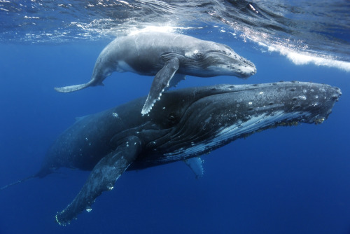
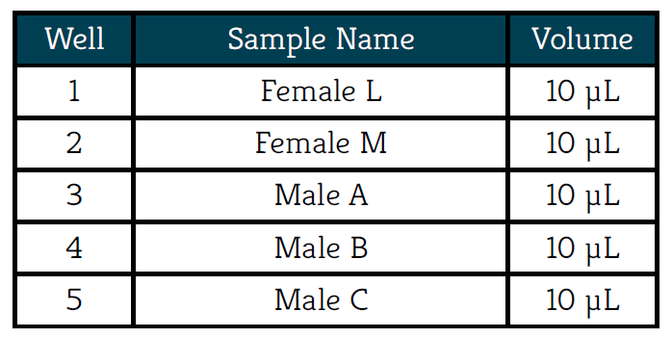
The Scenario: which whale is Luna’s father?
Scientists are using genetics to learn about the mating behaviors of humpback whales
By observing nursing patterns they know which whale is Luna’s mother
Based on mating behavior, her father could be one of three males
In this lab you will use DNA fingerprinting to determine which of these three males is Luna’s father

Slide 7
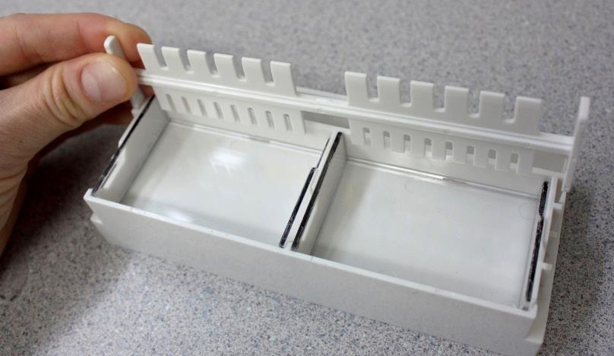
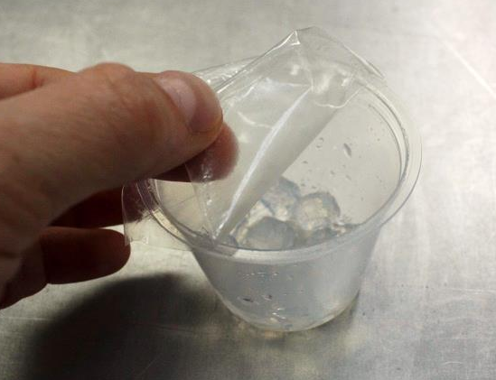
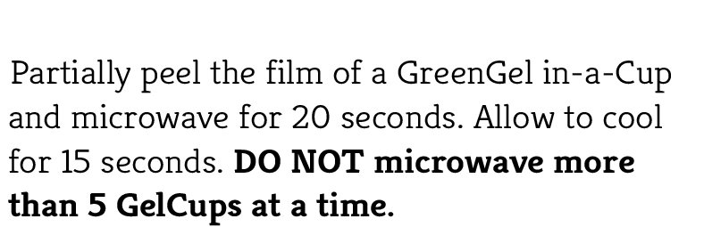
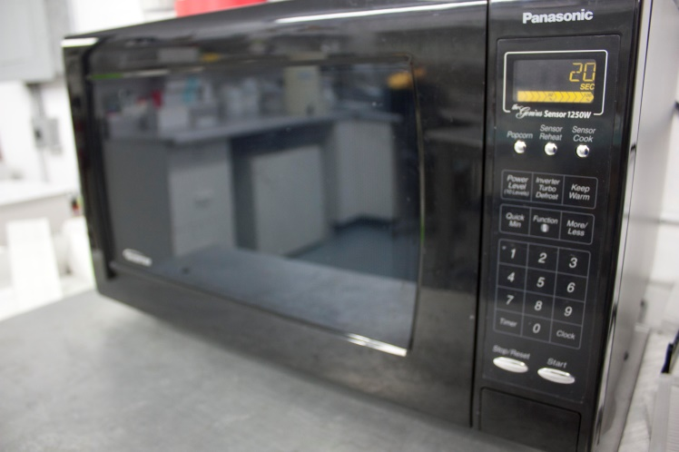
Cast the agarose gel
*Use the six-well side*

Slide 8
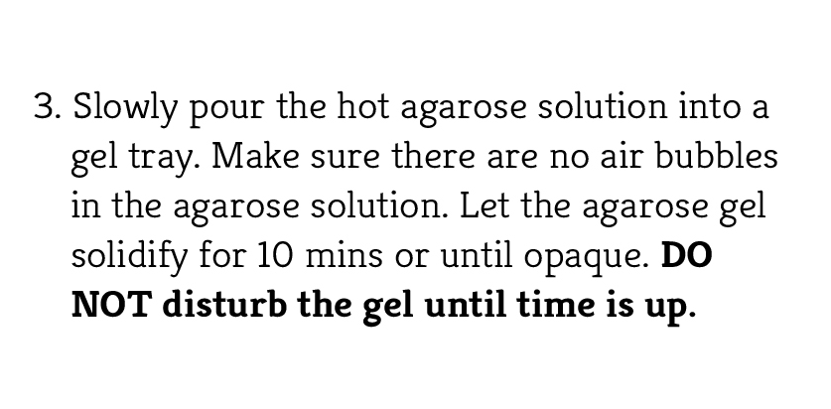
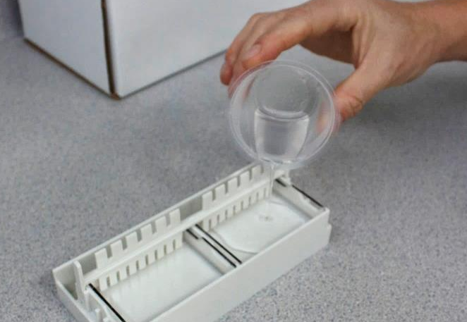
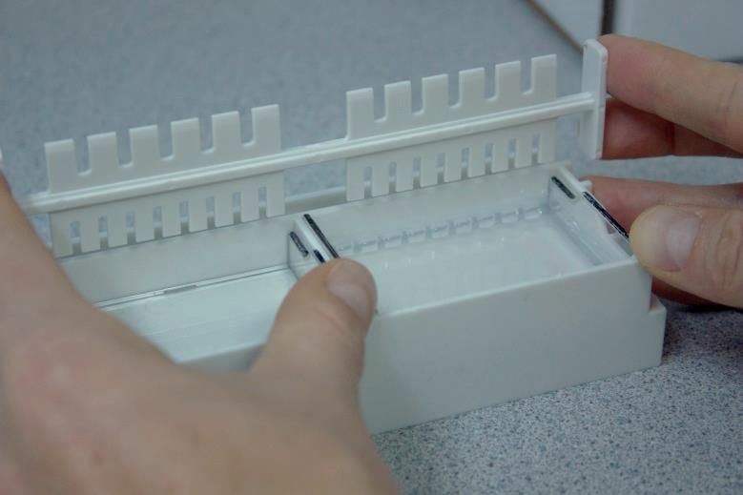
Cast the agarose gel

Slide 9
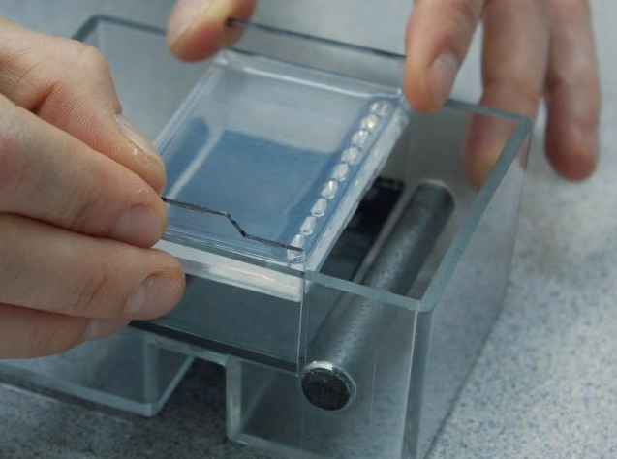
Prepare the MiniOne electrophoresis chamber

Slide 10
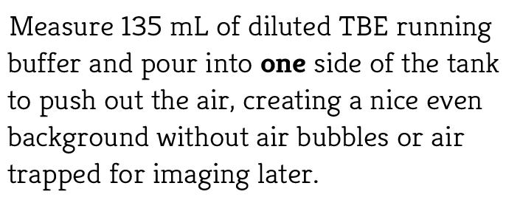
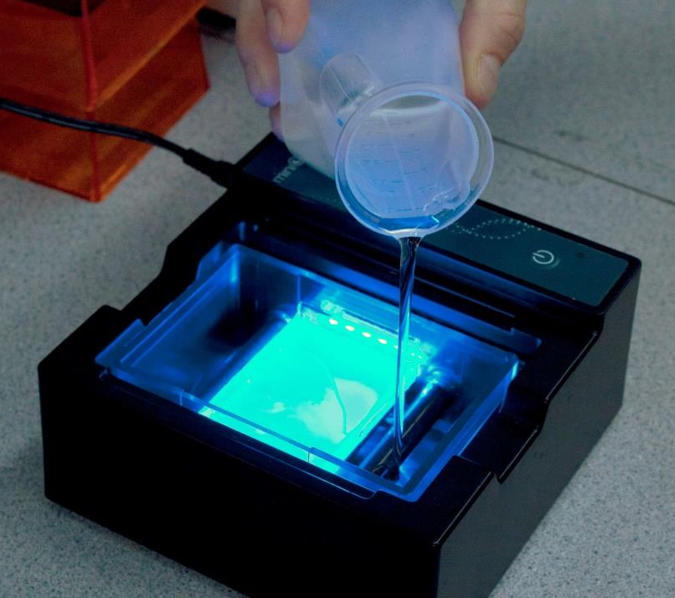
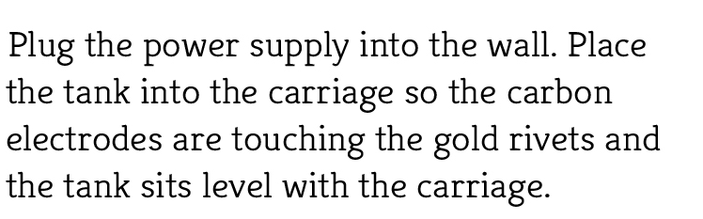
Prepare the MiniOne electrophoresis chamber

Slide 11
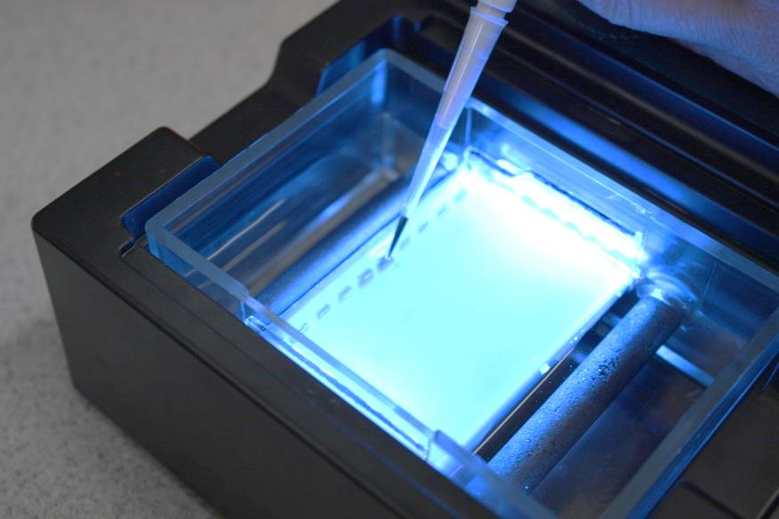
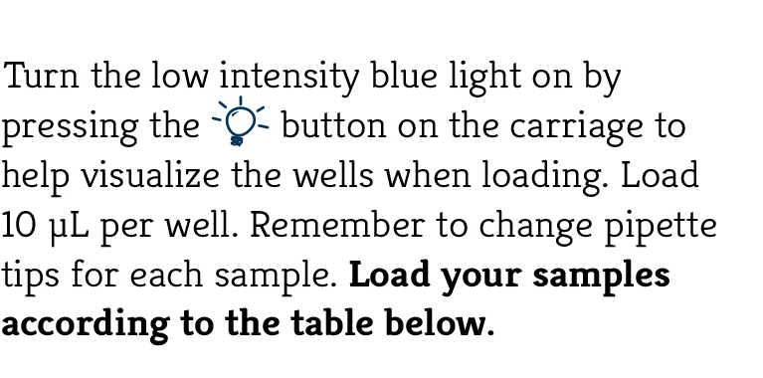
Load your samples

Slide 12
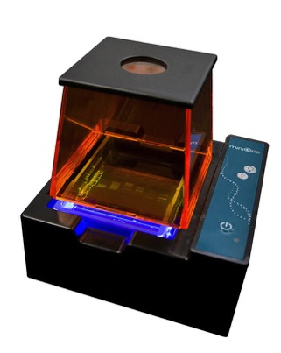
Run your gel

Slide 13
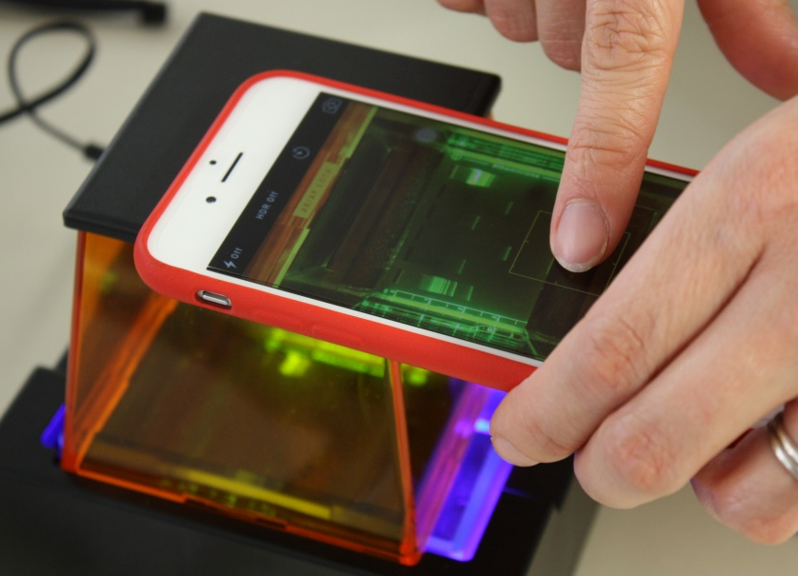
Document your results

Slide 14
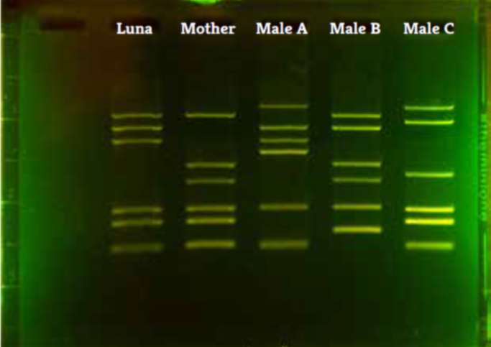
Example results
Which male is Luna’s father?

Slide 15
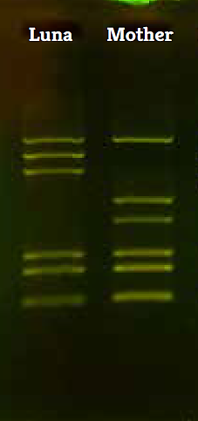
Example analysis:
**All bands not from the mother must have come from the father**
Step 1: determine which bands are present in Luna’s fingerprint, but missing in her mother’s fingerprint.

Slide 16
Example analysis:
Step 2: determine which male’s fingerprint contains ALL of the “missing” bands.
Conclusion: Only Male A contains both “missing” bands, therefore Male A is Luna’s father.

Slide 17
*Thank you for attending our workshop*
Please use the comment form if there is any feedback you would like to share.
Please contact us at info@theminione.com for more information or to request a quote.

