Slide 1
Circuits

Slide 2
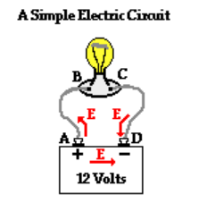
Electric Potential
The potential difference = amount of potential energy between two points on a circuit.
Electric Potential in a circuit. There is a positive(high potential energy) and a negative end(low potential energy) on a power source (battery or power supply).
There is a potential difference. Where a test charge will want to move from the positive end of the battery to the negative end of the battery without doing any work.
Remember: Positive and negative plate test charge

Slide 3
Ohm’s Law
The electrical current I, or movement of charge, that flows through most substances is directly proportional to the voltage V applied to it (learned from lab).
The electric property that impedes current (crudely similar to friction and air resistance) is called resistance R.
Correction: V/I = slope = Conductance NOT Capacitance

Slide 4
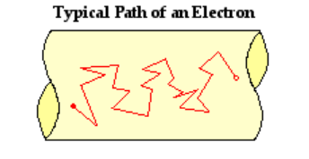
Current (I) Amperes (A) Cs⁻¹
A flow of charge within the circuit
An electrochemical cell (battery) or power supply supplies energy to establish a potential difference(V)
An electron is the actual charge carrier. Does not follow a straight path. Results from collisions with other atoms from the wire.
Most of the energy in the charge carrier gets lost as it goes through the circuit.
I= the total charge that moved past a point over the time taken for charge to move past the point

Slide 5
Current
The lower the value of the current, the slower the rate at which ions move.
What would impact current in a circuit?
A= Cross sectional area of the conductor (A)
n= the # of charge carriers that can move per m³
v= drift velocity- The average velocity of the free charges in a conductor
q=charge
I = nAvq

Slide 6
Drift Speed

Slide 7
Resistance(R)=ohms $Ω$
The opposition that a substance offers to the flow of electric current
The resistance of an object (i.e., a resistor ) depends on its shape and the material of which it is composed.
Similar to the resistance to the flow of water through a pipe.

Slide 8
Resistance depends on
A= cross sectional area of the conductor
L=length of conductor

Slide 9
Resistance depends on
The material the wire is made of
For example, current flows more easily through conductors and less so with insulators
The quantitative measure of a material’s opposition to the flow of current is called resistivity($ρ)$

Slide 10
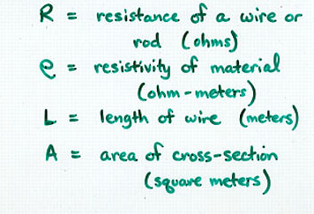
Resistance and Resisitivity
R= $\frac{ρL}{A}$
$ρ$=$\frac{\text{RA}}{L}$
Resistivity quantifies how strongly that material opposes the flow of electric current

Slide 11
Ohm’s Law Revisited
$∆V=IR$ aka V=IR
The electric potential difference between two points on a circuit (ΔV) is equivalent to the product of the current between those two points (I) and the total resistance of all electrical devices present between those two points (R).

Slide 12
Power
The rate at which electrical energy is supplied to a circuit or consumed by a load.
Electric circuits are designed to serve a useful function.
Ex. light bulb or a motor is called load
P= Work done on a charge/ time = Js⁻¹=Watts

Slide 13
Power Equations
P=$\frac{V^{2}}{R}$
P= I²R

Slide 14
Putting it all together

